Slide 1

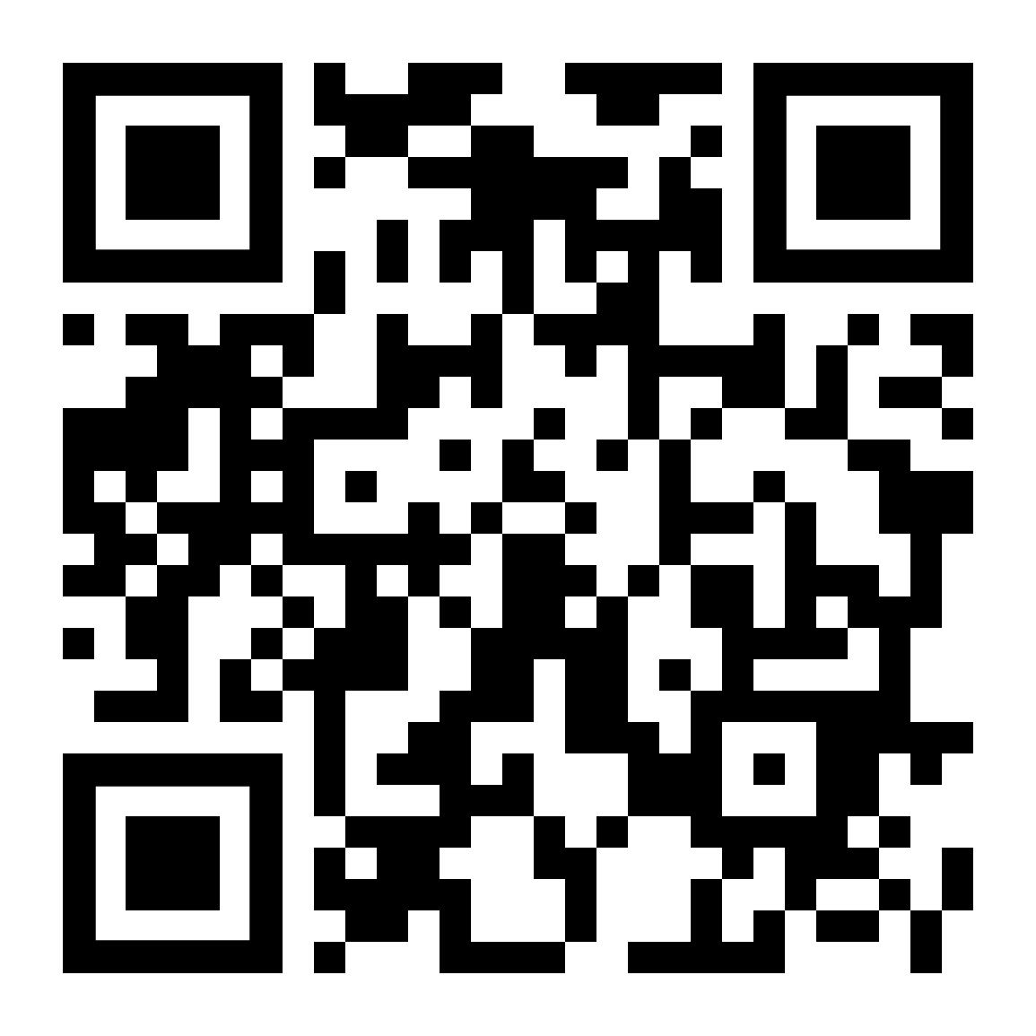
Demo Accounts
URL: https://www.demo.myon.com
School Name: Demo Building
ROLE | USERNAME | PASSWORD
Student | Student689 | password
Faculty | Faculty56 | password

Slide 2
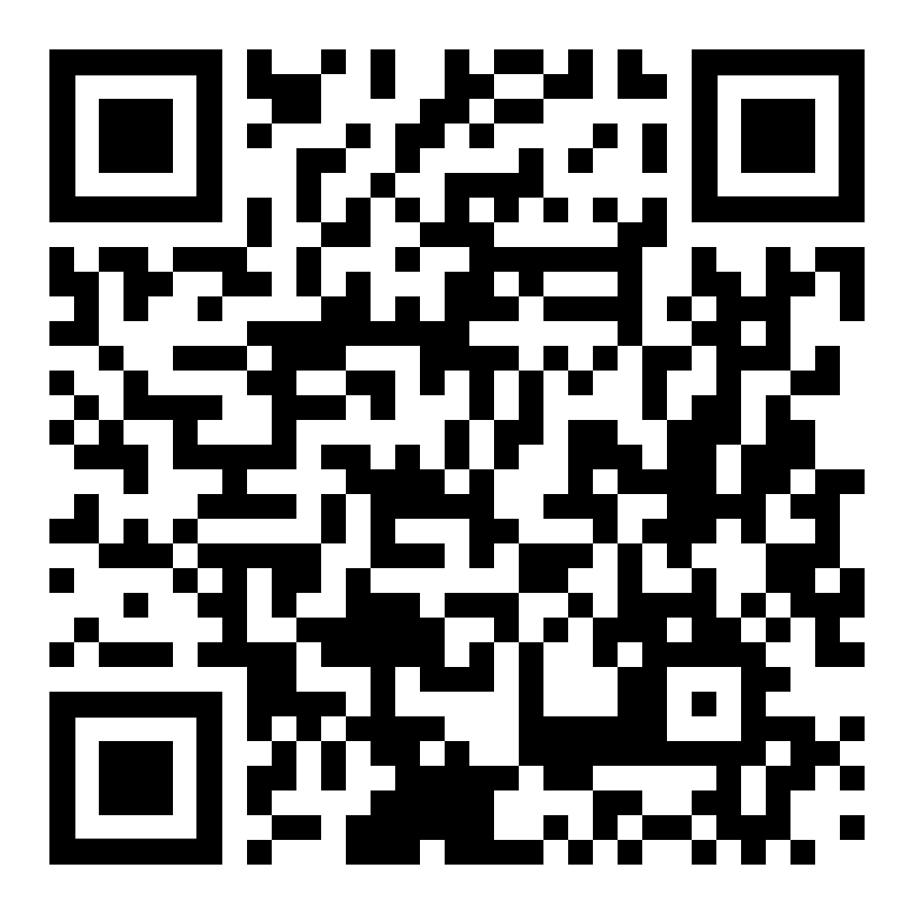
Logging in
URL: https://global-zone20.renaissance-go.com/welcomeportal/17776

Slide 3
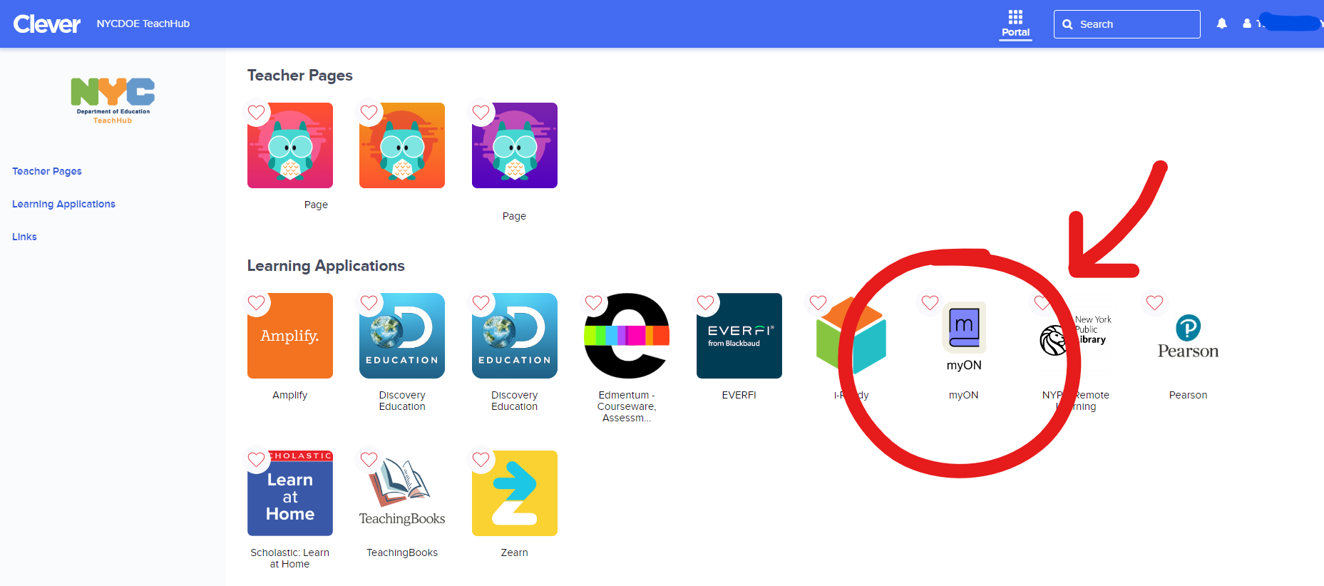
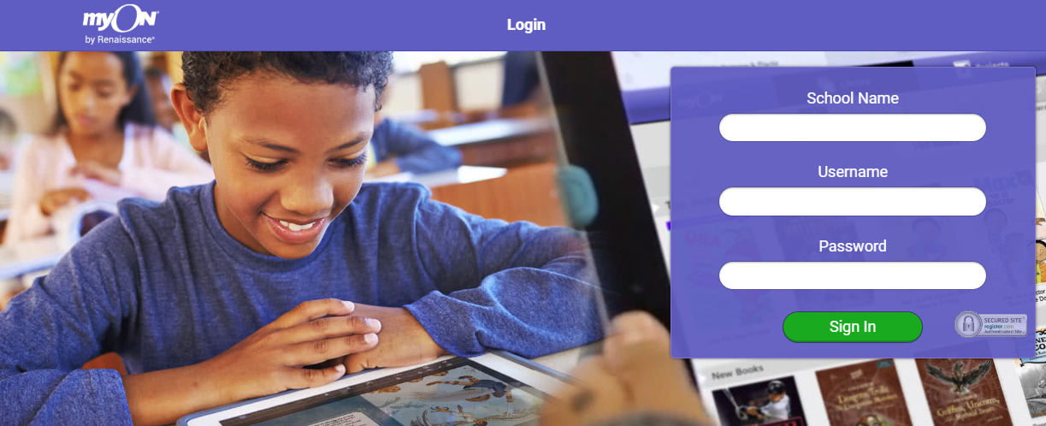
Two Ways to Login
1
2
Teach Hub → Clever
Teachers and Students
(Student UN/PW: same as google)
Step 1 : Go to Teach Hub
Step 2 : Go to Clever
Step 3: Search and Click myON Tile
www.myon.com
Administrators
Paraprofessionals
Students (UN: OSIS PW: read)
Teacher Demo Login (UN:dbnteacher PW:NYC)
Notes:
Show when you start the live demo
This is the clever login info, MOST schools use clever, a handful use myon.com and Carmel hill uses rgp, they should know who they are.

Slide 4
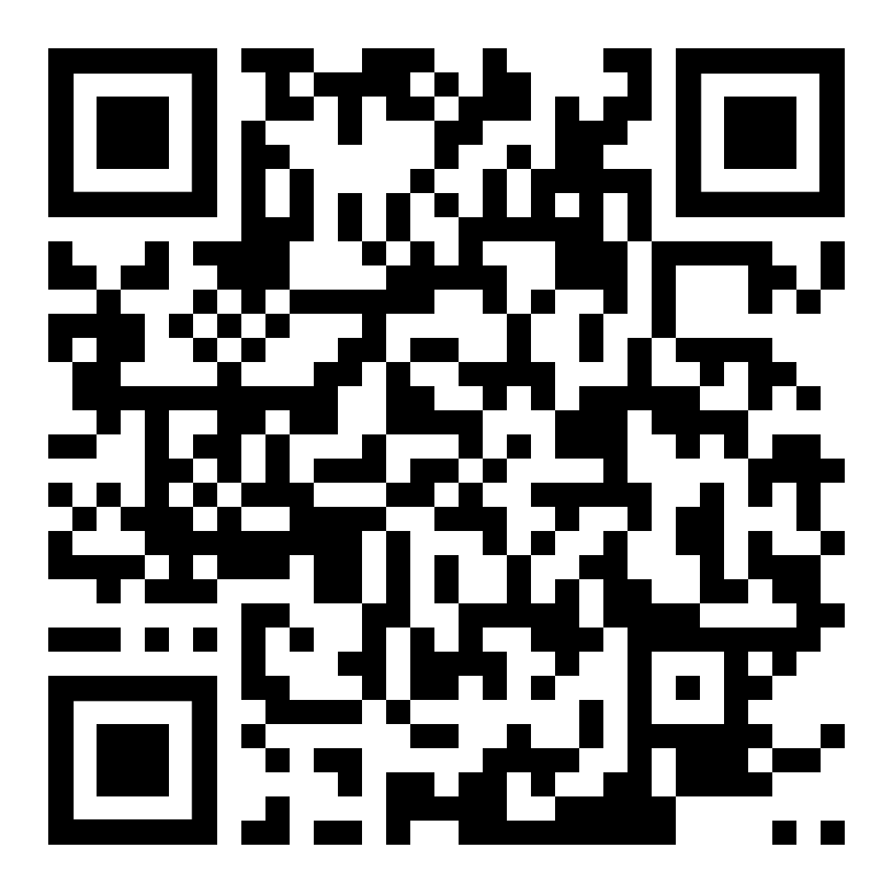

https://short.renaissance.com/D5LTGPLSurvey
See Every Student.

Slide 5
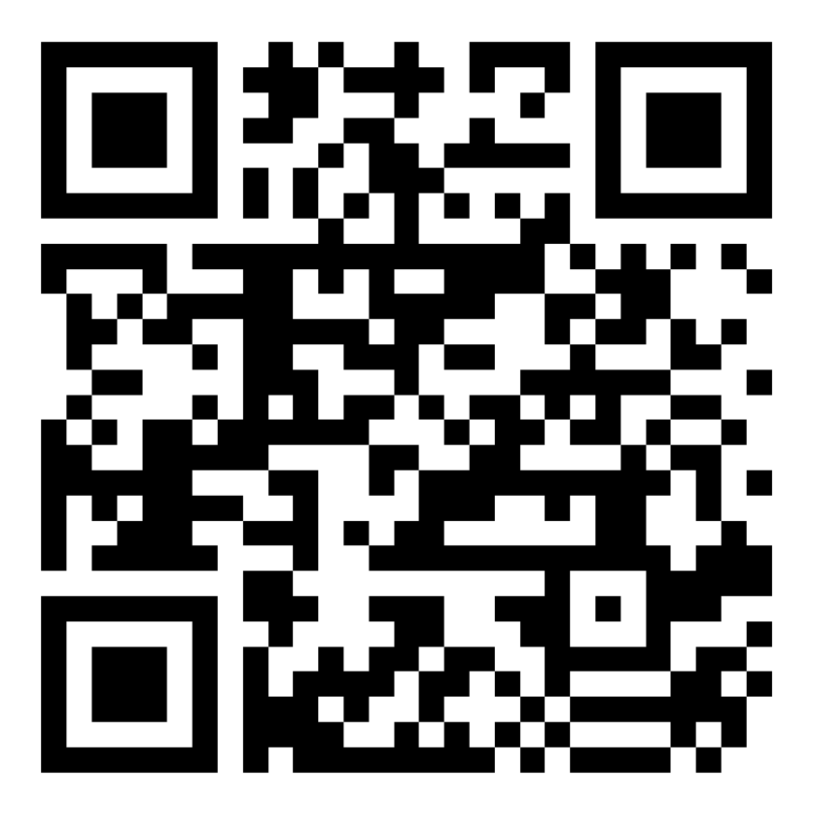
https://short.renaissance.com/CTLEFORM
See Every Student.

